Slide 1
Global Design Workshop
Cash Management
9th November 2022

Slide 2
Agenda
Topic | Duration
Introductions, Workshop Approach & Objective | 10 min
Workshop Objective Objective Workshop Expectations Rules of the Road Program Timeline | 10 min
Signature Requirement & Pain Points Process Taxonomy User Persona Pain Points Signature Requirements | 15 min
Manage Bank Transaction Deep Dive Bank Account Maintenance Bank Statement Processing Reconciliation Cash Forecasting Cash Positioning Bank Account Transfer | 60 min
User Stories, Leading Practices , Key Design Decisions | 10 min
Reporting | 5 min
Summary and Next Steps | 5 min
Objectives & Outputs
Define key Concepts
Overview of Personas
Standard Future State Process Walkthrough
Leading Practices & Key Design Decisions
Parking Lot Items
Notes:
Workshop Approach
Scope and Req
Capability Scope for Lead-to-Order
2 min
Customer Management Pain Points
10 min
Signature Requirements
5 min

Slide 3
Workshop Objective (10 min)
Objective
Workshop Expectations
Rules of the Road
Program Timeline

Slide 4
Objective
Workshop Expectations
Rules Of The Road
Program Timeline
Objectives
Banks
Documents and align on Key Design Decisions and Future State Processes of Bank and Accounts maintenance for ERP CM
Bank Reconciliation
Review the existing Bank Reconciliation process and align on KDDs for future state process.
CM Additional Features
Review Additional Features to Cash Management: Seeded Bank Statement formats, Parse Rule Sets

Slide 5
Workshop Expectations
Objective
Workshop Expectations
Rules Of The Road
Program Timeline
Address Current State Pain Points
Run Exception-Based Workshops
Confirm Requirements
Key Activities:
Discuss Current State Pain Points
Discuss how Oracle standard capabilities on Manage Bank process
Key Activities:
Review Manage Bank Process Taxonomy Scope
Review leading practices
Discuss framework for proposed Structure
Key Activities:
Captured the user stories
Confirm To-Be Bank Process

Slide 6

Global Design Workshop - Rules of the Road
Objective
Workshop Expectations
Rules Of The Road
Program Timeline
Updated Version
Workshop Materials
1
All Global Design Decks will be uploaded to Deloitte Teams 24hrs prior to the workshop for the attendees.
After workshops have concluded the recordings and meeting minutes will be uploaded to correct session folder.
Clear Objectives and Outcome
2
Deloitte Leads will include a slide that outlines a clear and concise objective for the session.
Additionally, a section on the actual outcomes of the session will be provided.
Clearly lay out to TD attendees what we are asking from you.
Scribes
4
Scribes will be ready and available to take notes for the workshop.
Will monitor the chat for any questions/comments.
Present captured items at the end of every session.
Invitations for Audience
3
Deloitte Leads will provide more detailed Agendas for the audience on the invites.
Deloitte Leads will indicate whether the session is a deep dive.
Based off agenda TD Functional Leads will identify the required personnel for the meeting.
Notes:
Tags: customer, journey, person, circle, arrow

Slide 7
Program Timeline with Details
Objective
Workshop Expectations
Rules Of The Road
Program Timeline
Solution Lifecycle Stages
Imagine
Deliver
Run
M1 | M2 | M3 | M4 | M5 | M6 | M7 | M8 | M9 | M10 | M11 | M12 | M13 | M14 | M15 | M16 | M17 | M18 | M19 | M20 | M21 | M22 | M23 | M24
Oct | Nov | Dec | Jan | Feb | Mar | Apr | May | Jun | Jul | Aug | Sep | Oct | Nov | Dec | Jan | Feb | Mar | Apr | May | Jun | Jul | Aug | Sept
Program
Kick Off
Global Design
Finalize COA, Enterprise Structure
Capture User Stories (Requirements)
Update Process Flows
Disposition Parking Lot Items (e.g., KDDs)
Global Design
Workshops
Walk the Wall
MC = Mock Conversion
MC&C = Mock Conversion & Cutover
INT / SIT = System Integration Testing
UAT = User Acceptance Testing
UATPT = User Acceptance Parallel Testing
Finalize KDDs
Design/ Requirements Freeze
Phase 1a
Kick Off
Phase 1a
ERP Go Live
Phase 1a
EPM Go Live
Ent. Structure & Chart of Accounts, MDM & Hierarchy, reporting, tech. architecture
OP
Phase 1a
Prep
Design Sessions, Deployment / Testing Approach, Sprint Plan
Development Sprints
UATPT2
MC&C
INT1
UAT
UATPT1
Cutover
Phase 1a Code Freeze
Hypercare
OP
Phase 1b
Phase 1b
Kick Off
MDM
Go live
Phase 1b Go Live
SFDC, Order Orchestration, Invoice to Cash
Prep
Design Sessions, Finalize KDDs, Deployment / Testing Approach, Sprint Plan
Development Sprints
INT1
INT2
INT3
UAT
Cutover
MC1
MC2
MC3
MC UAT
Phase 1b Code Freeze
Hypercare
Phase 2
Kick Off
Supply Chain & Finance
Phase 2 Go Live
OP
Phase 2
Prep
Design Sessions, Finalize KDDs, Deployment / Testing Approach, Sprint Plan
Development Sprints
INT1
INT2
UAT
Cutover
MC1
MC2
MC UAT
Phase 2
Code Freeze
Hypercare

Slide 8
Signature Requirements & Pain-Points (15 min)
Manage Bank Transaction Process Taxonomy
User Persona
Pain Points
Signature Requirement

Slide 9
Enterprise Structure L1/L2 Process Taxonomy Session Scope
Process Taxonomy
User Personas
Pain Points
Signature Requirement
Level 1 | Develop Vision & Strategy | Develop Products & Services | Market Products & Services | Sell Products & Services | Manage Customer Services | Order to Fulfill | Invoice to Cash | Record to Report | Financial Planning and Analysis | Procure to Pay, Acquire Capital | Develop & Manage Human Capital | Provide Information Technology | Manage External Relationships | Manage Enterprise Risk, legal, Ethics and Compliance | Develop and Manage Business Capabilities
 | Define the business concept and long-term vision | Govern & manage product/services management program (PMM) | Develop Marketing Plans | Analyze the Sales Area | Develop customer care / customer service strategy | Perform Order Management | Process Customer Credit (Check) | Manage the General Ledger | Perform planning, budgeting, forecasting | Determine Sourcing Strategy, Policies, Governance | Develop and manage HR polices and strategies | Develop & manage business partner relationships | Build Investor Relations | Manage Enterprise Risk | Manage business processes
 | Develop Business Strategy | Manage product and service life cycle (UOL) | Perform customer and market intelligence analysis | Develop Sales Operating Plan | Plan and manage customer service contracts | Deliver Physical Products | Invoice Customer | Perform Transaction Processing | Perform cost accounting and control | Vendor Management | Recruit, source and select employees | Develop and manage IT business strategy | Manage government and industry relationships | Manage Ethics and Compliance | Manage portfolio, program and project (PMO)
 | Execute and measure strategic initiatives | Manage patents, copyrights, and regulatory requirements | Develop marketing communication strategy | Manage Customer Relationships | Service products after sales | Deliver Software | Process Accounts Receivable | Perform Closing | Perform cost management | Requisition, PO, Receipt of goods and services | Manage employee on boarding, development and training | Develop and manage IT resilience and risk | Manage Board of Directors | Manage remediation program | Manage enterprise quality
 | Develop and maintain business models | Manage product and service master data | Design and manage customer loyalty program | Manage Leads / Opportunities | Manage product recalls and regulatory audits | Deliver Services (Cons, MS, TS) | Manage and Process Collections | Recognize Revenue | Evaluate and manage financial performance | Process Accounts Payable | Manage employee relations | Manage information | Manage legal issues | Manage business resiliency | Manage change
 |  |  | Develop and manage promotional activities | Renewal Management | Evaluate customer service operations & customer satisfaction | Deliver Cloud Onboarding Services |  | Manage Fixed Assets |  | Process Employee Reimbursable Expenses | Reward and retain employees | Develop and Manage services and solutions | Manage public relations program | Manage Internal Controls | Develop & manage knowledge management capability
 |  |  | Product Marketing/Launch Process (PMM) | Develop and manage sales partner/alliance relationships |  |  |  | Administer Payroll |  | Manage Corporate Credit Card | Redeploy and retire employees | Deploy services solutions |  |  | Measure and benchmark
 |  |  |  | Develop Sales Forecasts |  |  |  | Manage Treasury Operations |  | Acquire Manage Real Estate / Facility Portfolio | Manage employee information and analytics | Create and manage support service solutions |  |  | Manage environmental health and safety
 |  |  |  | Manage and Evaluate Performance |  |  |  | Manage Taxes |  |  | Manage employee communication |  |  |  | Develop, manage and deliver analytics
 |  |  |  | Manage Customer Success |  |  |  | Financial & Operational Reporting |  |  |  |  |  |  | Manage enterprise security
 |  |  |  | Manage Tools, Tech, Customer Data
 |  |  |  | Measure Customer Satisfaction
Level 2
Bank Account Maintenance
Bank Statement Processing
Reconciliation
Cash Forecasting
Cash Positioning
Bank Account Transfer

Slide 10
Process Taxonomy
User Personas
Pain Points
Signature Requirement
User Persona
Role | Role Description | Responsibilities
Cash Management Analyst​ | Manage bank, branches and bank accounts​ | Create multiple banks, branches and bank accounts as per business needs​
Cash Management Supervisor​ | Review the created bank accounts​ | Verify the bank account set up created by cash management analyst​

Slide 11
Process Taxonomy
User Persona
Pain Points
Signature Requirement
Cash Management Pain Points
Capability | Pain Points
Maintain Bank Accounts and Reconciliation | Treasury relies heavily on MS Excel, which makes making changes to banking structure very difficult. Treasury management system (TMS) approval is pending to validate align with ERP + planning Reporting from GL or HFM/IDW on different views (legal entity, by bank, by currency) of cash and investment is limited. Manual journal entries are performed for IC loan revaluation, IC loan and external debt interest accruals, external debt issuance cost amortization, etc Transaction currency reporting is difficult and unavailable in HFM/IDW. IC settlement is a time consuming/ manual process performed in MS Excel. There is need to redenominate IC transactions from USD to local currency, centralizing FX risk on TD Ireland, establish multi-lateral netting process with streamlined intercompany posting/clearing.​ Timing of certain entries/ accruals can create an issue with balance sheet exposures and hedge positions. India IC consulting, for example, is booked very late and has fx exposure implications. With balance sheet and P&L transaction currency reporting available, would examine our balance sheet hedging program and establish a cash flow hedging program.
The above paint points were captured during Optimus Prime vendor evaluation workshops
Key
Today’s Focus
In Scope
Not in Scope

Slide 12
Process Taxonomy
User Persona
Pain Points
Signature Requirements
Signature Requirements
ID | L1 | L2 | Requirement Description
RTR_084 | Record to Report | Bank/ Treasury | Ability to integrate bank statement information with ERP to perform bank reconciliation against payables and receivables transactions.
RTR_085 |  |  | Ability to process bank charges, interest charges and other charges not affiliated to payables or receivables to generate accounting for these transactions
RTR_086 |  |  | Ability to automatically reconcile bank statements against transactions to avoid manual reconciliation
RTR_087 |  |  | Ability to generate standard reports to identify the unreconciled GL cash account journal entries and unreconciled bank statement lines so that the discrepancies between the balances can be resolved.
RTR_089 |  |  | Ability to have automatic data import from banking systems (direct from major banks and local operating accounts)
RTR_090 |  |  | Ability to perform bank to GL reconciliation
RTR_091 |  |  | Ability to have bank account management / administration
RTR_092 |  |  | Ability to view the balance on cash account and also the system to calculate cash position

Slide 13
Concept Deep Dive (60 min)
Bank Account Maintenance
Bank Statement Processing
Reconciliation
Cash Forecasting
Cash Positioning
Bank Account Transfer

Slide 14
Bank Account Maintenance
Bank Statement Processing
Reconciliation
Cash Forecasting
Cash Positioning
Bank Account Transfer
Bank Account Maintenance : Process Flow

Slide 15
Bank Account Maintenance
Bank Statement Processing
Reconciliation
Cash Forecasting
Cash Positioning
Bank Account Transfer
Bank Account Maintenance
Banks, branches, and accounts fit together on the premise of the Bank Account model. The model enables to define and keep track of all bank accounts in one place and explicitly grant account access to:
Multiple business units
Functions
Users
Banks
Creating a bank is the first step in the bank account creation.
Branches
Once bank is created, the next step is creating a branch or branches associated to the bank. The matching option is also available when creating branches. To create a new branch without using the matching option, manually enter the required information. You can also define other branch- related attributes in the same page.
Accounts
After creation of branch, create the bank account. The four areas associated with defining an account are:
General information
Control of the account
Security and access to the account
Business unit assignment

Slide 16
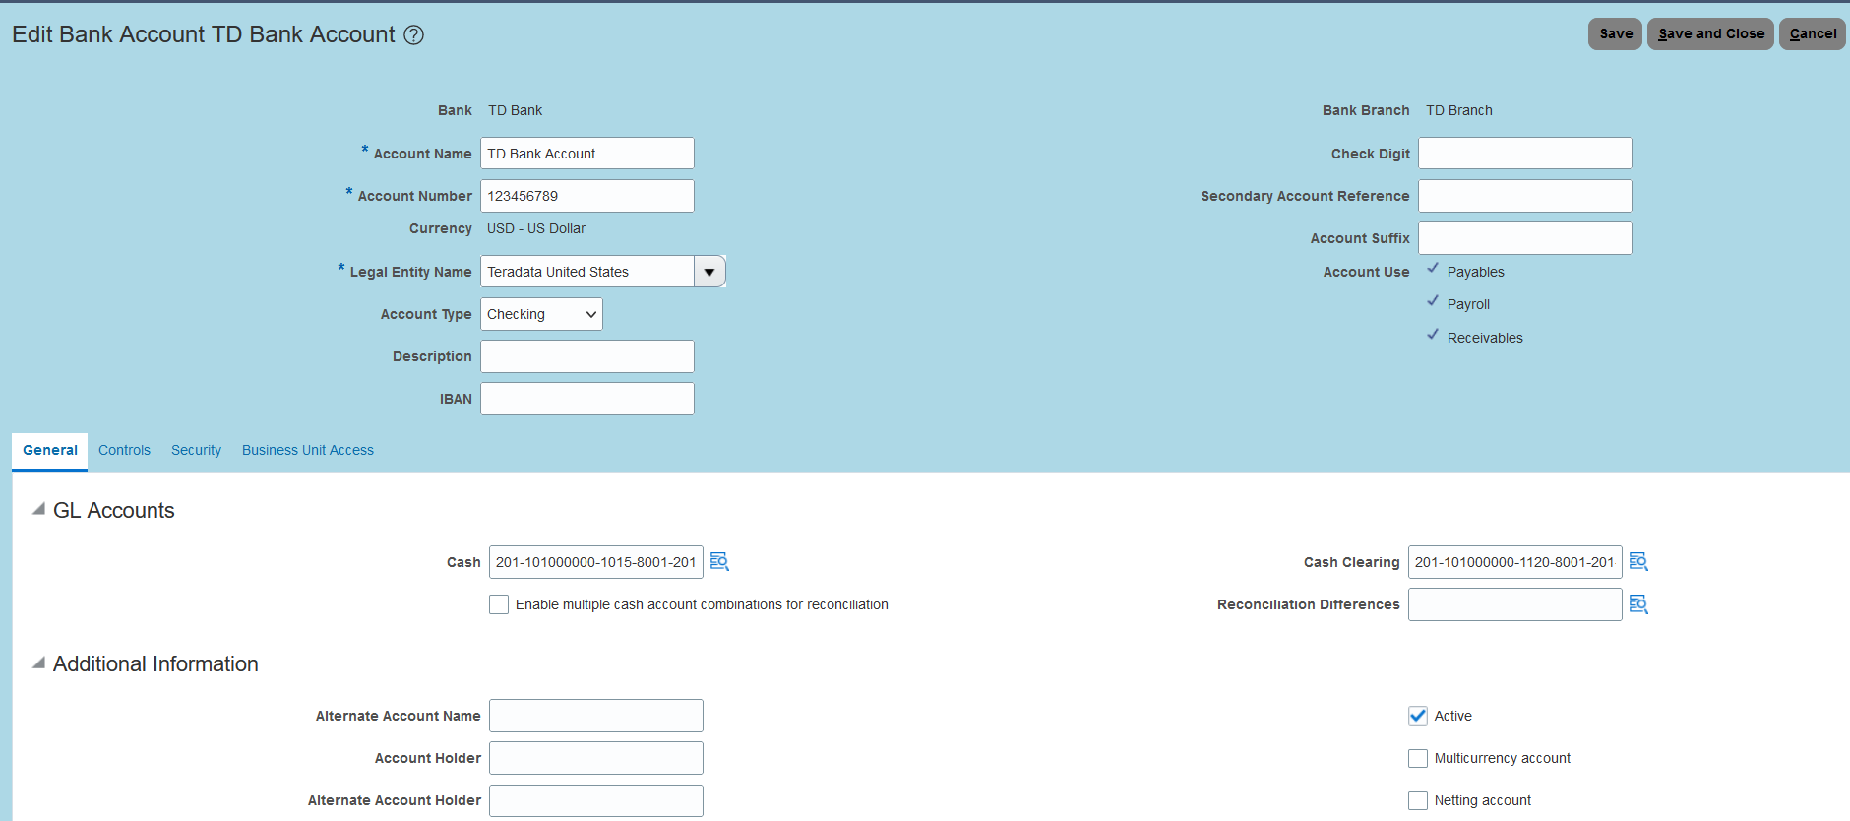
Bank Account Maintenance
Bank Statement Processing
Reconciliation
Cash Forecasting
Cash Positioning
Bank Account Transfer
Bank, Branch and Bank Account Setup

Slide 17
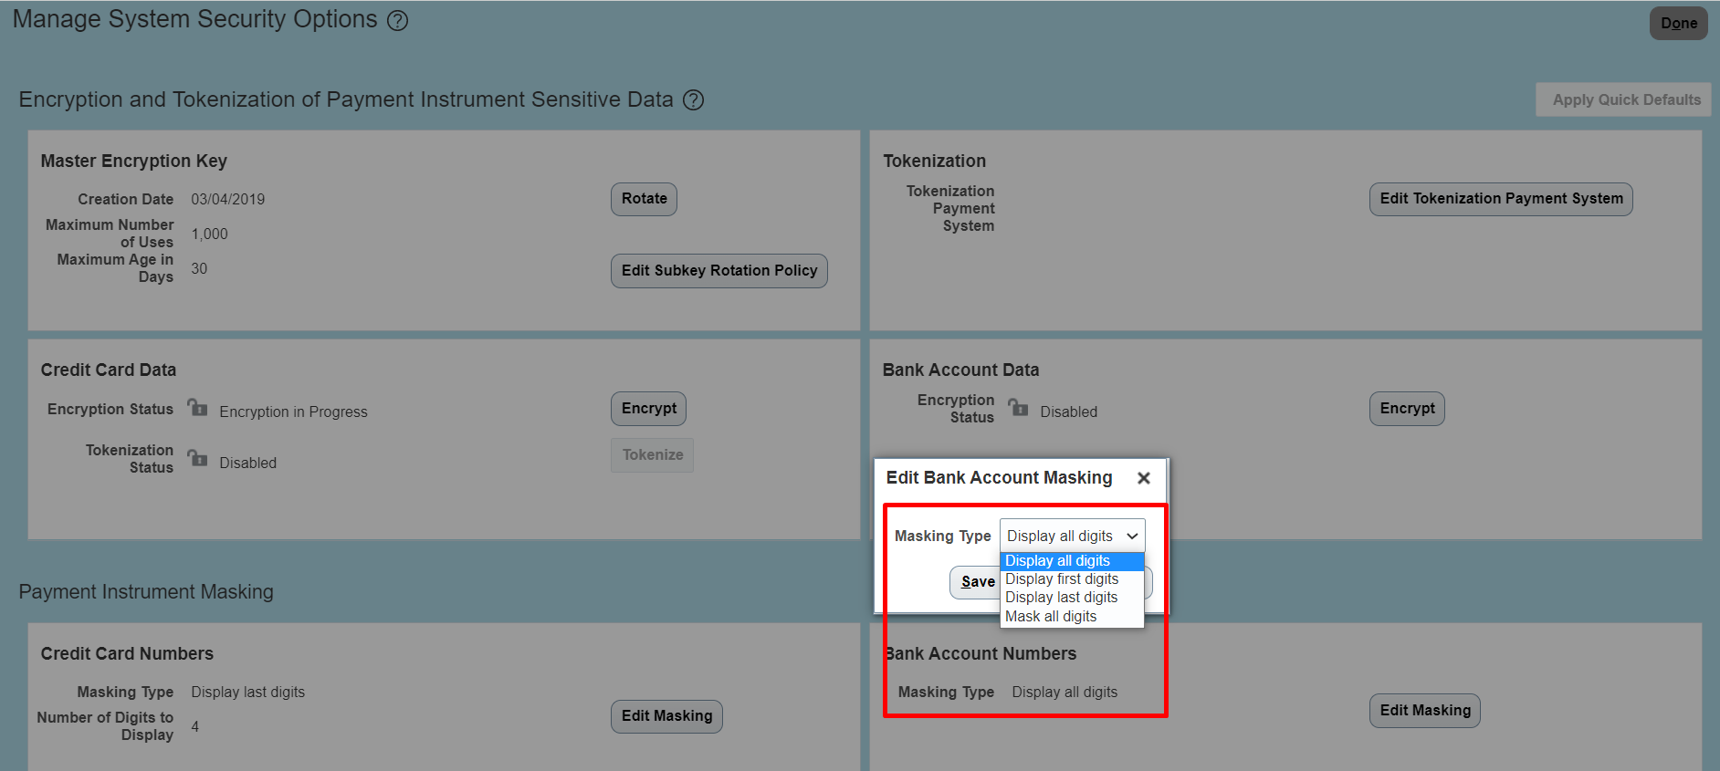
Bank Account Maintenance
Bank Statement Processing
Reconciliation
Cash Forecasting
Cash Positioning
Bank Account Transfer
Bank Account Security Options

Slide 18
Bank Account Maintenance
Bank Statement Processing
Reconciliation
Cash Forecasting
Cash Positioning
Bank Account Transfer
Manage Cash Management Structure – Bank Validations
When creating a new Bank / Branch / Account Oracle checks for unique banks, branches, accounts, and makes bank account number mandatory
Additionally, Oracle has pre-built country specific validations for below fields:
Bank Code
Branch Number
Account Number
Check Digit
IBAN
Using setup these country specific validations can be disabled (Related profile option: Disable Country Specific Bank Validations)
Recommended Practice
Highly recommended to not disable (i.e., keep enabled) country specific bank validations as they are built by Oracle based on requirements in each of those countries. Data quality issues on Bank / Branch / Account should be addressed when loading instead of disabling validations.

Slide 19
Bank Account Maintenance
Bank Statement Processing
Reconciliation
Cash Forecasting
Cash Positioning
Bank Account Transfer
Bank Account Maintenance
Once the bank and branch are created, proceed to the bank account setup by doing the following:
Select the bank branch that want to associate to bank account.
Assign the owner of the bank account
There are two ways to create banks, branches and bank accounts in the system:
Manual
Spreadsheet
Recommended Practice
Maintain unique GL Cash Account value for each bank Account​ Utilize one Cash clearing Account across bank accounts​ Maintain quality of Master data e.g: Avoid creating duplicate bank or branches Establish a way to uniquely tie a GL account/ account combination to each bank account enabling faster reconciliation of GL with Bank statement
Key Question​
Determine number of banks, branches and bank accounts used​

Slide 20
Bank Account Maintenance
Bank Statement Processing
Reconciliation
Cash Forecasting
Cash Positioning
Bank Account Transfer
Bank Statement Processing and Reconciliation : Process Flow

Slide 21
Bank Account Maintenance
Bank Statement Processing
Reconciliation
Cash Forecasting
Cash Positioning
Bank Account Transfer
Bank Statement Process

Slide 22
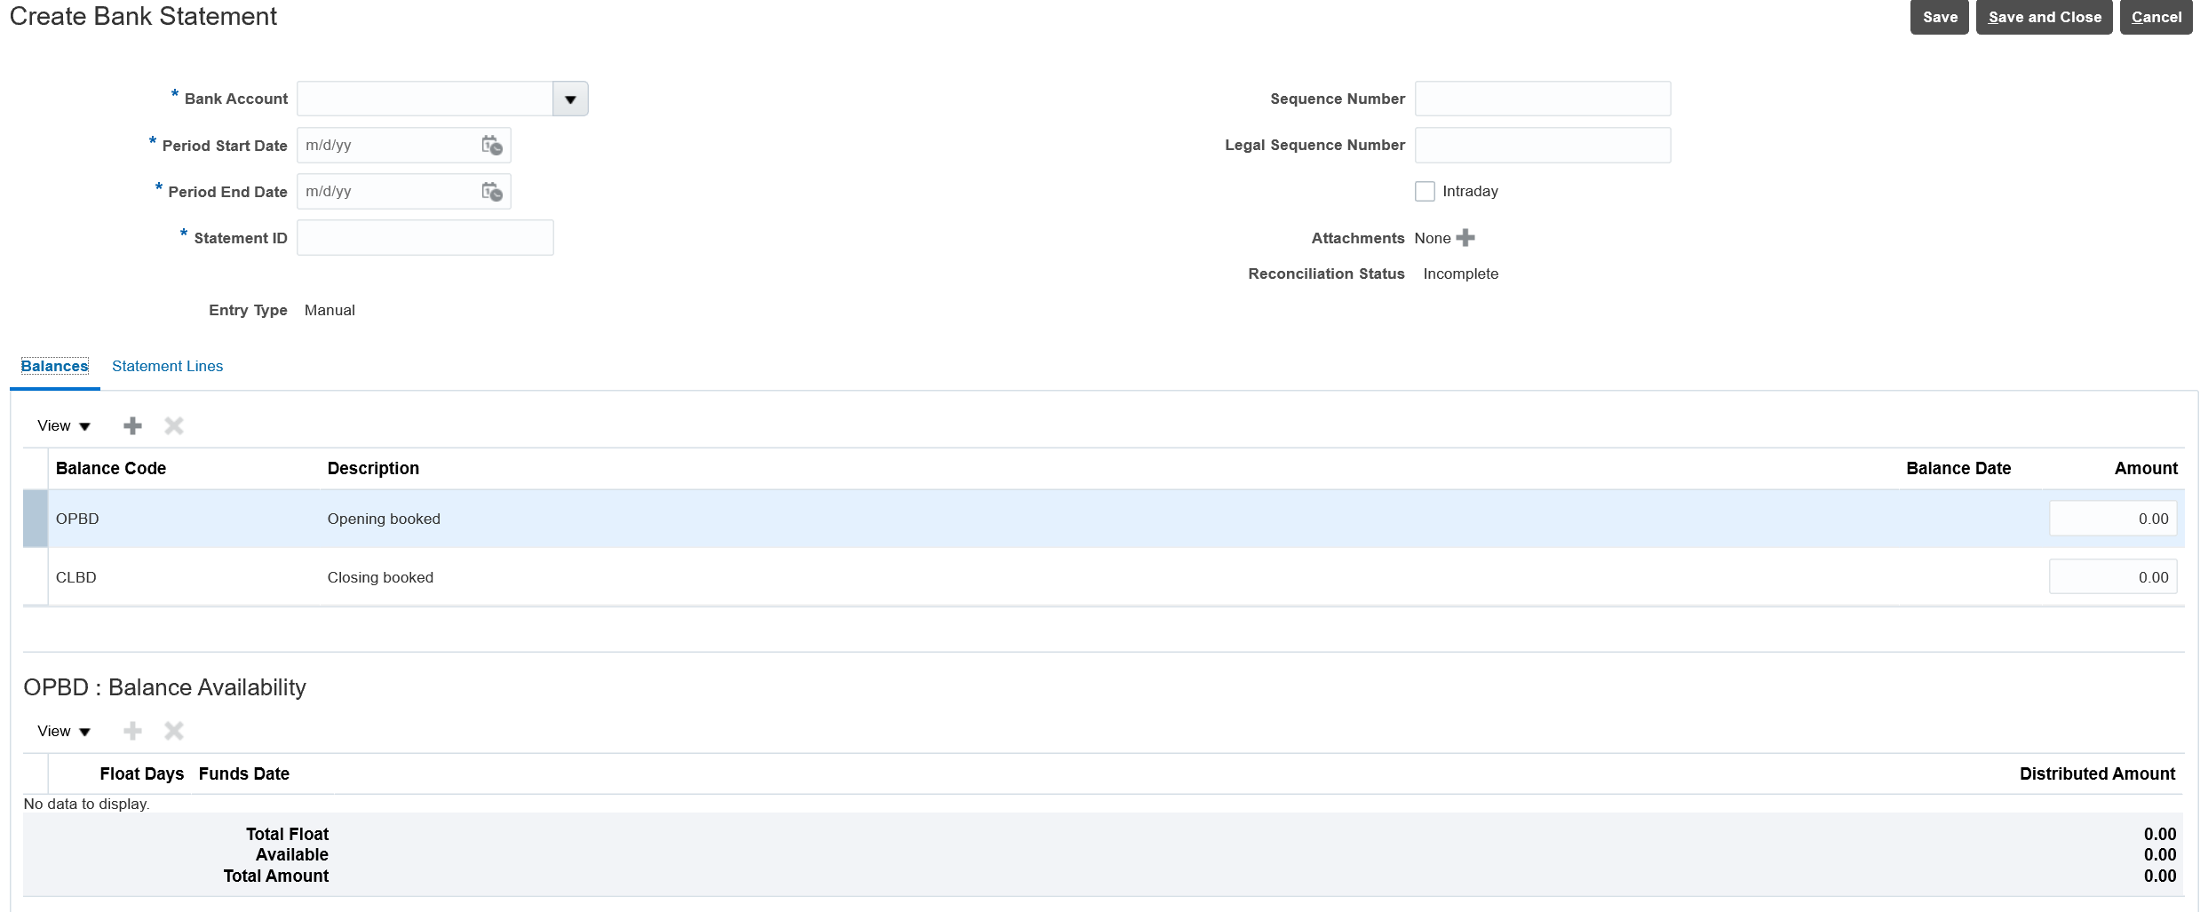
Bank Account Maintenance
Bank Statement Processing
Reconciliation
Cash Forecasting
Cash Positioning
Bank Account Transfer
Manage Bank Statements
Bank Statements can be created manually or imported automatically into Oracle Cash Management
Automatic Import
Manual Entry
An Interface that imports bank statements into Oracle Cash Management
Manually enter the bank statement details in from the ‘Create Bank Statement’ page
Bank places the bank statement file (BAI2, SWIFT MT 940, CAMT) in the SFTP file location
(Kyriba will collate to one format and sent to Oracle)
“Process Electronic Bank Statements” program is scheduled to run daily. This program picks up files from the SFTP location with the help of Transmission Configurations defined in the system.
“Process Electronic Bank Statements” program automatically loads and imports the statements into Oracle Cash Management

Slide 23
Bank Account Maintenance
Bank Statement Processing
Reconciliation
Cash Forecasting
Cash Positioning
Bank Account Transfer
Loading Bank Statements
The following electronic bank statement file formats are supported by Oracle Fusion Cash Management
BAI2
SWIFT (MT940)
EDIFACT (FINSTA)
ISO20022 CAMT052 V1 - camt.052.001.01
ISO20022 CAMT053 V1 - camt.053.001.01
ISO20022 CAMT053 V2 - camt.053.001.02
Recommended Practice
Utilize standard bank statements formats across all entities (to the extent possible)​ Automate bank statement interface as much as possible​ Bank statement should provide appropriate details for ease of reconciliation. (ex - bank name, bank branch, bank account number, reference number, payment number, receipt, check number)
Discussion​
Determine the format of the bank statement to import and upload the bank statement directly into the system​ We understand that Kyriba provides the bank statements in a standardized format for reconciliation in CM. In your current state, is the bank reconciliation process primarily automatic or needs manual intervention? What are the scenarios in which manual reconciliation is needed?

Slide 24
Bank Account Maintenance
Bank Statement Processing
Reconciliation
Cash Forecasting
Cash Positioning
Bank Account Transfer
Bank Statement Processing and Reconciliation
Bank Statement Reconciliation | Bank Statement Clearing Process | Multi-Currency Handling
Cash Management integrates with different applications like receivables, payables, payroll. There are two major process steps need to follow when reconciling bank statements:
Load Bank Statements: Enter the detailed information from each bank statement, including bank account information, deposits received by the bank, and payments cleared. Bank statements can be entered manually or load electronic statements that receives directly from bank.
Reconcile Bank Statements: Once entered detailed bank statement information into Cash Management, we must reconcile that information with system transactions. Cash Management provides two methods of reconciliation:
Automatic reconciliation: Bank statement details are automatically matched and reconciled with system transactions. This method is ideally suited for bank accounts that have a high volume of transactions.
Manual: This method requires to manually match bank statement details with system transactions. The method is ideally suited to reconciling bank accounts that have a small volume of monthly transactions. We can also use the manual reconciliation method to reconcile any bank statement details that could not be reconciled automatically.
Miscellaneous Transactions: During the reconciliation process, we can create miscellaneous transactions for bank-originated entries, such as bank charges and interest. We can also manually enter Payables payments or Receivables receipts. The automatic reconciliation process can be set up to create miscellaneous transactions automatically.

Slide 25
Bank Account Maintenance
Bank Statement Processing
Reconciliation
Cash Forecasting
Cash Positioning
Bank Account Transfer
Bank Statement Reconciliation
Bank Statement Reconciliation | Bank Statement Clearing Process | Multi-Currency Handling
Key Questions
How are bank reconciliation errors handled? What are the prevalent matching criteria for reconciliation of bank statements? If the matching criteria is not met, what are the remediation steps undertaken?
Recommended Practice
Utilize automate bank reconciliations and restrict manual reconciliation only for resolving discrepancies​
Discussion​
Determine the different type of transactions​ Determine the method used for reconciliation of bank statements with other modules like payables and receivables​ Determine the process to apply bank charges​ Determine the option for multiple currency transactions to enable at bank account setup level​

Slide 26
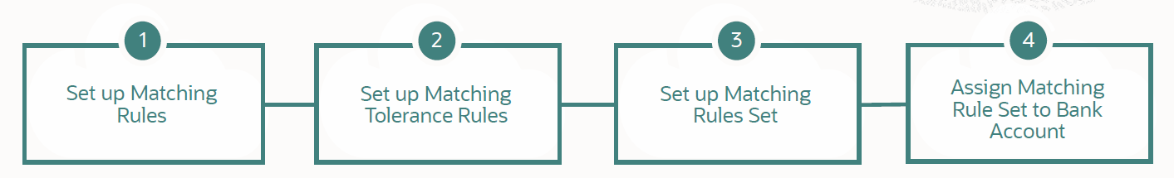
Bank Account Maintenance
Bank Statement Processing
Reconciliation
Cash Forecasting
Cash Positioning
Bank Account Transfer
Setup for Bank Reconciliation - Automatic
Bank Statement Reconciliation | Bank Statement Clearing Process | Multi-Currency Handling
Cloud Oracle (key out of box setups available For Reconciliation)
Tolerance Rules: Define date and amount tolerance rules to be used for manual and automatic reconciliation
Flexible Matching Rules: Allows to select the criteria for matching and not rely on predefined criteria
Configurable Rule Sets: Increases automatic reconciliation hit rate and minimizes manual reconciliation
Cloud provides seeded bank statement processing formats like for ISO20022 (new), BAI2, SWIFT, and FINSTA
Parse rule sets provides ability to parse information on the statement into named attributes which can be used for reconciliation

Slide 27
Bank Account Maintenance
Bank Statement Processing
Reconciliation
Cash Forecasting
Cash Positioning
Bank Account Transfer
Bank Statement Reconciliation | Bank Statement Clearing Process | Multi-Currency Handling
Create Reconciliation Matching Rule
Matching Rule | Tolerance Rule | Matching Rule Set | Assign Matching Rule Set to Bank Account
✓ Transaction Sources: Payables, Receivables, Payroll, External
✓ Matching Type: Group by attributes for bank statement lines or system transactions, depending upon match type
• One to One
• One to Many
• Many to One
• Many to Many
✓ Matching Criteria: List of matching attributes:
• Amount (always checked)
• Date
• Reconciliation Reference
• Transaction Type
• Use Advanced Criteria

Slide 28
Bank Account Maintenance
Bank Statement Processing
Reconciliation
Cash Forecasting
Cash Positioning
Bank Account Transfer
Bank Statement Reconciliation | Bank Statement Clearing Process | Multi-Currency Handling
Create Reconciliation Matching Rule
Matching Rule | Tolerance Rule | Matching Rule Set | Assign Matching Rule Set to Bank Account
One to One
One Bank Statement Line Matches to One System Transaction
• Bank Statement Line and System Transaction needs to have the same amount
• User can define other attributes as matching criteria as: Date, Reconciliation Reference, Transaction Type, or they can enter advanced criteria manually
One to Many
One Bank Statement Line Matches to Many System Transactions
• Define Attributes to Group System Transactions and match them with One Bank Statement Line
Many to One
Many Bank Statement Lines Match to One System Transaction
• Define Attributes to Group Statement Lines and match them with One System Transaction
Many to Many
Many Bank Statement Lines Match to Many System Transactions
• Define Attributes to Group Bank Statement Lines and System Transactions, resulting in a unique matching results

Slide 29
Bank Statement Reconciliation | Bank Statement Clearing Process | Multi-Currency Handling
Matching Rule | Tolerance Rule | Matching Rule Set | Assign Matching Rule Set to Bank Account
Tolerance Rule Setup
Tolerance Rules enables to specify date and amount tolerances that prevent or warn when reconciliation would be a breach of a defined tolerance.
Date tolerance are to validate that the source transaction date or dates are within a certain number of days before and after the bank statement line date or dates.
Amount tolerances are most often - used when reconciling foreign currency transactions where there may be differences due to rounding or fluctuations in the conversion rate. They can also be used if a bank includes a processing fee in the bank statement line amount.
✓Reconciliation amount tolerances can be defined as percentage or amount ranges or both. If both percentages and amounts are applied, the application uses the most conservative tolerance depending upon the statement line amount

Slide 30
Bank Statement Reconciliation | Bank Statement Clearing Process | Multi-Currency Handling
Matching Rule | Tolerance Rule | Matching Rule Set | Assign Matching Rule Set to Bank Account
Matching Rule Set
Bank Statement Reconciliation Rule Set is a group of Matching Rules and Tolerance Rules.
Each Rule Set consists of one or more Matching Rules that can be prioritized or sequenced.
The Rules should be ordered to achieve a greater reconciliation success rate.

Slide 31
Bank Statement Reconciliation | Bank Statement Clearing Process | Multi-Currency Handling
Matching Rule | Tolerance Rule | Matching Rule Set | Assign Matching Rule Set to Bank Account
Assign Matching Rule Set to Bank Account
Tie the Rule Set to the Bank Account.
Same Rule Set can be used for Multiple Bank Accounts.

Slide 32



Bank Statement Reconciliation | Bank Statement Clearing Process | Multi-Currency Handling
Integration with Payables and Receivables
Phase 1b
Phase 2
Cash Management
Bank Statement
Cash Management
Bank Statement
Source
Source
Receivables
Receivables | Payables
Miscellaneous Cash Transactions
Miscellaneous Cash Transactions
Payables/ Payroll from EBS
Payroll from Workday
Oracle Cloud General Ledger
Oracle Cloud General Ledger

Slide 33
Bank Account Maintenance
Bank Statement Processing
Reconciliation
Cash Forecasting
Cash Positioning
Bank Account Transfer
Bank Statement Reconciliation | Bank Statement Clearing Process | Multi-Currency Handling
Bank Statement Clearing Process
When reconcile a transaction, the transaction is first matched to bank statement details and then cleared (if uncleared). Alternatively, it can manually clear Payables payments, Receivables receipts, miscellaneous transactions, open interface transactions, and Cash Management cashflows (except for those created from bank statement lines) in Cash Management prior to reconciliation to maintain more up-to-date cash account balances.
When clear a transaction, Cash Management assigns a cleared date, cleared amount, and status to the transaction. Accounting for the cleared transaction varies by the source.
Miscellaneous Transactions: During the reconciliation process, we can create miscellaneous transactions for bank-originated entries, such as bank charges and interest. We can also manually enter Payables payments or Receivables receipts. The automatic reconciliation process can be set up to create miscellaneous transactions automatically.
Key Questions
How are miscellaneous charges like bank charges, interests etc. currently managed? Do you create miscellaneous transactions for the same? If yes, are those created automatically or manually?
Notes:
We can also use Automatic Clearing to clear receipts in Oracle Receivables.
If the transaction is a payment: Payables records the accounting information, but you create the accounting entries in Payables.
If the transaction is a receipt or a miscellaneous transaction: Receivables automatically generates the accounting entries.
You cannot clear Payroll payments, General Ledger journal entries, or Treasury settlements.
Cash Management integrates with Payables and use Cash Management to reconcile payment transactions. Record miscellaneous transactions that are on bank statements such as bank charges, or bank errors. If we use Cash Management to record miscellaneous transactions, then we must install and set up Receivables, since miscellaneous payments in Cash Management are negative miscellaneous receipts.

Slide 34
Bank Account Maintenance
Bank Statement Processing
Reconciliation
Cash Forecasting
Cash Positioning
Bank Account Transfer
Bank Statement Reconciliation | Bank Statement Clearing Process | Multi-Currency Handling
Multi-Currency Handling
Cash Management handles foreign currency transactions during both automatic and manual bank reconciliation.
In order to calculate the exchange rate gains and losses resulting from foreign currency transactions in both the International and Foreign scenarios, the bank statement transaction line must include, in addition to Currency, at least one of the following types of exchange rate information:
Original Amount
Exchange Rate
Exchange Rate Type and Exchange Rate Date
Additionally, Cash Management uses the exchange rate information to match foreign currency transactions in a multi-currency bank account.
Key Questions
Do you observe foreign currency transactions that need to be managed? If yes, what all regions come under this purview?

Slide 35
Bank Account Maintenance
Bank Statement Processing
Reconciliation
Cash Forecasting
Cash Positioning
Bank Account Transfer
Cash Forecasting
Cash forecasting is a planning tool that helps to anticipate the flow of cash in and out of the business, allowing to project cash needs and evaluate company's liquidity position.
Create cash forecast templates, from which a periodic cash forecasts projecting cash flow can be generated. Once a cash forecast is generated, we can modify, query, and report on it, and easily export it to any spreadsheet application.
We can create an unlimited number of cash forecasts. A cash forecast is in a spreadsheet format, including rows (cash inflow or outflow source types) and columns (forecasting periods). At the intersection of each row and column are cells containing forecast amounts.
Create forecasts using data across organizations, and in any currency. Also use cash forecasting to help determine the degree of currency exposure.
We have the flexibility to include or exclude overdue transactions for all appropriate source transaction types in forecasts.
Cash inflow information is immediately accessible to the cash forecast process in Oracle Cash Management from Oracle Receivables, Oracle Order Management, Oracle Sales, Oracle General Ledger, and Oracle Treasury.
Cash outflow information comes from Oracle Payables, Oracle Purchasing, Oracle Payroll, Oracle General Ledger, and Oracle Treasury.
Key Questions
What sort of aging buckets do you use for cash requirements forecasting (i.e. 30, 60, 90...)? Do you foresee any changes to the same to meet your future state's expectations? What are additional pain points pertaining to cash management, reconciliations and forecasting?

Slide 36
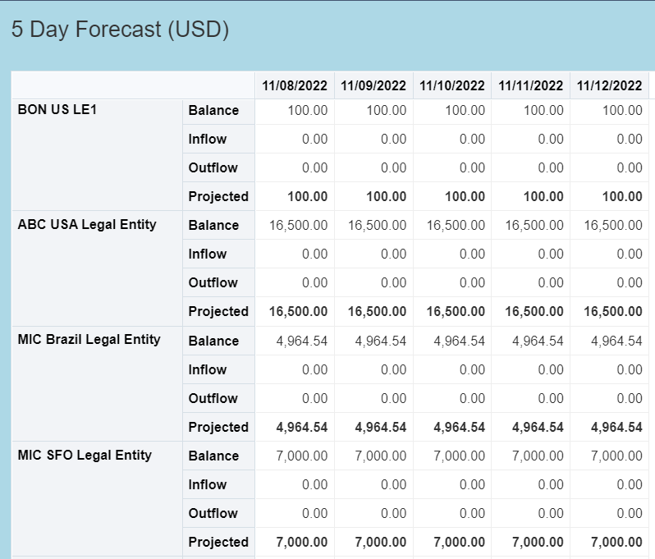
Bank Account Maintenance
Bank Statement Processing
Reconciliation
Cash Forecasting
Cash Positioning
Bank Account Transfer
Cash Forecasting

Slide 37
Integration with Cash Forecasting
Automatic integration with Oracle Applications provides you with enterprise-wide cash information. All source types, except for User-defined and Open Interface Inflows and Outflows, supply data from other Oracle Applications to a cash forecast.
The following table contains details on various cash inflow source types.
Source | Source Type | Description
Receivables | Customer Invoices | Unpaid invoices
 | Customer Receipts (Historical) | Cleared cash receipts, excluding reversed receipts
 | Customer Receipts (Future) | Uncleared cash receipts, excluding reversed receipts
Order Entry | Sales Orders | Uninvoiced sales orders that are projected to be paid by customer excluding commitments
General Ledger | GL Budgets | Revenue account budget amounts
Treasury | Treasury Transactions | Money market, foreign exchange, and exposure transactions.
External Source | Open Interface Inflow | External forecast source inflow transactions
User | User-defined Inflow | Manually entered forecast amounts

Slide 38
The following table contains details on various cash outflow source types.
Source | Source Type | Description
Payables | Supplier Invoices | Unpaid invoices, excluding prepayments
 | Supplier Payments (Historical) | Cleared disbursements, excluding void payments
 | Supplier Payments (Future) | Uncleared disbursements, excluding void payments
 | Expense Reports | Expense reports that have not been invoiced
Payroll | Payroll Expenses (Historical) | Paid payroll
Purchasing | Purchase Orders | Uninvoiced purchase orders
 | Purchase Requisitions | Unordered requisitions
General Ledger | GL Encumbrances | Unused portion of encumbered amounts for expenses and assets
 | GL Budgets | Expense account budget amounts
Treasury | Treasury Transactions | Money market, foreign exchange, and exposure transactions
External Source | Open Interface Outflow | Outflow transactions from external sources
User | User-defined Outflow | Manually entered forecast amounts

Slide 39
Bank Account Maintenance
Bank Statement Processing
Reconciliation
Cash Forecasting
Cash Positioning
Bank Account Transfer
Cash Forecast & Positioning
The Oracle Cash Management Cash Positioning and Forecasting provide solutions to accurately report cash balances and position.

Slide 40
Bank Account Maintenance
Bank Statement Processing
Reconciliation
Cash Forecasting
Cash Positioning
Bank Account Transfer
Cash Positioning
Cash positioning is a planning tool that helps to view daily cash position by currency or bank account.
Cash positioning allows to project the cash needs and evaluate company's liquidity position.
The daily cash positions are based on actual cash flows from various Oracle Applications.
We can generate a daily cash position for a single currency, multiple currencies, a single bank account, multiple bank accounts, a single Legal Entity, or multiple Legal Entities.
Calculation of Opening and Closing Bank Account Balances in Cash Positioning
The opening bank account balance displayed in the cash position results is the previous day's closing bank account balance for that bank account.
If the previous day's closing balance is not available, then the latest available bank account balances are displayed instead. In this case, the cash position results also display a Prior Day Cashflows row that includes transactions between the latest available balance date and the Cash Position As of Date.
The closing balance is calculated as Opening Balance + Prior Day Cash Flows + Net Cash Flow.
For cash pools included in the cash position, the opening balance is the sum of the previous day's balances or the last available balance for all the bank accounts included in the cash pool.

Slide 41
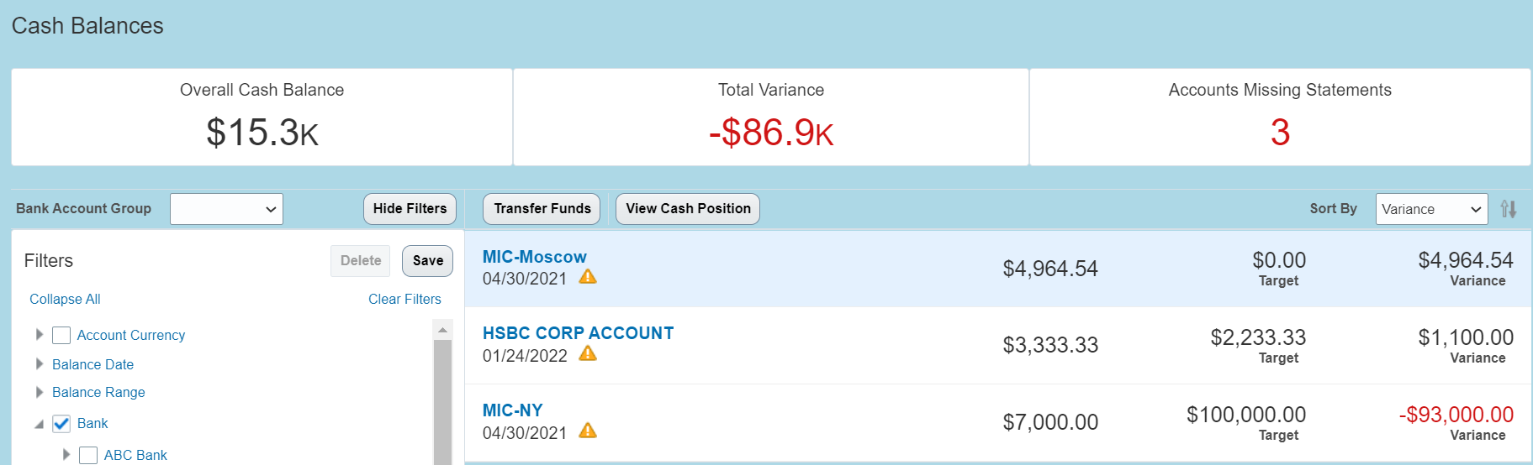
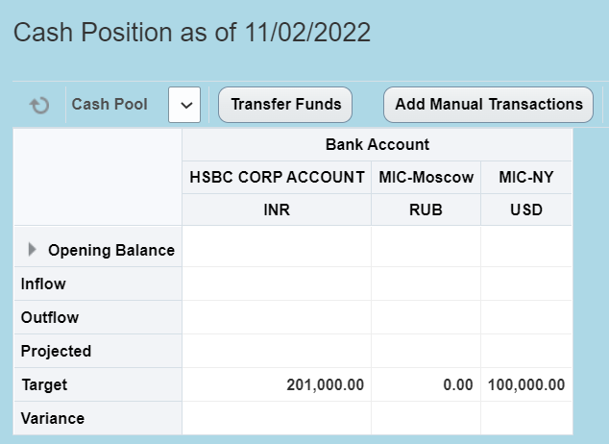
Bank Account Maintenance
Bank Statement Processing
Reconciliation
Cash Forecasting
Cash Positioning
Bank Account Transfer
Cash Positioning

Slide 42
Bank Account Maintenance
Bank Statement Processing
Reconciliation
Cash Forecasting
Cash Positioning
Bank Account Transfer
Bank Account Transfer

Slide 43
Bank Account Maintenance
Bank Statement Processing
Reconciliation
Cash Forecasting
Cash Positioning
Bank Account Transfer
Bank Account Transfer
Bank account transfers represent fund transfers between internal bank accounts.
Bank account transfers can be created manually or automatically through Cash Leveling process and/or Sweep Transactions Generation concurrent program.
The access to bank account transfer creation for a particular legal entity is subject to bank account use security.
The bank account transfers are reflected in Cash Position automatically. Payment processing for bank account transfers is managed using Oracle Payments. Journal entries are created through a centralized subledger accounting engine.
The following bank account transfers are supported from the point of view of bank account ownership:
1. Intra-Company Transfers
Intra-company transfers represent cash transfers between two internal bank accounts that belong to the same legal entity.
2. Inter-Company Transfers
Inter-company transfers represent cash transfers between two internal bank accounts that belong to two different legal entities. In case of such transfers, the system can produce balanced journal entries for both legal entities.

Slide 44
Bank Account Maintenance
Bank Statement Processing
Reconciliation
Cash Forecasting
Cash Positioning
Bank Account Transfer
Bank Account Transfer
The following bank account transfers are supported from the point of view of transfer currency:
1. Domestic : The currency of both bank accounts and the transfer amount is the same.
For example, transferring USD between two bank accounts that are denominated in USD.
2. International: The currency of one bank account is the same as the currency of the transfer amount but the currency of the other bank account is different.
For example, transferring USD from a bank account denominated in USD to the bank account denominated in EUR.

Slide 45
User Stories, Leading Practices and KDD’s
Sample User Stories

Slide 46
Key User Stories
No. | User Story Description
1​ | As a cash management analyst, I want to able to receive electronic bank statements and import them into the system to perform bank reconciliation against payables and receivables transactions. ​
2​ | As a cash management analyst, I want to able to manually enter bank statements to perform bank reconciliation against payables and receivables transactions​
3​ | As a cash management analyst, I want to able to process bank charges, interest charges and other charges not affiliated to payables or receivables and generate accounting for these transactions.​
4​ | As a cash management analyst, I want to able to systematically identify outstanding checks, deposits and adjustments that have not cleared for bank reconciliation​
5​ | As a cash management analyst, I want to able to view the balance on cash account and also the system to calculate cash position​
6​ | As a cash management analyst, I want to able to automatically reconcile bank statements against transactions​
7​ | As a cash management analyst, I want to generate standard reports to analyze balances and transaction details​
8​ | As a cash management analyst, I want to able to generate standard reports to identify the unreconciled GL cash account journal entries and unreconciled bank statement lines so that the discrepancies between the balances can be resolved.​
9​ | As a cash management supervisor, I want to able to review and resolve bank auto-reconciliation errors ​
10 | As a cash management analyst, I want to able to create multiple banks, branches and accounts (for payroll, receivables and payables). ​
11 | As a cash management supervisor, I want to able to secure bank information access by user and roles​
12 | As a cash management supervisor, I want to able to verify bank account setup in the system​

Slide 47
RICEW Objects, Reporting & Dashboards
RICEW Objects
Reporting

Slide 48
RICEW Objects
Reporting
RICEW Objects – Manage Cash Management*
No | RICEW Description | Object Type | Comments
1 | CM External Transaction Details Report | Report | External Transaction Detail Report fetched the details if External Transactions and considers both unreconciled and reconciled transaction details for all the Ad hoc Payments and Bank Account Transfers.
2 | Bank Statement Import to Oracle Cash Management | Interface | Bank Statement Import to Cash Management
*This is interim list only, for discussion purpose during design workshop

Slide 49
Out of Box Reports
RICEW Objects
Reporting
No | Bank Statement Reports | Description
1​ | Bank Statement Report​ | Displays the bank statements that are used to analyze balances and transaction details​
2​ | Bank Statement Analysis Report​ | Displays bank statements used to analyze balances and transaction details.​
No | Cash Transit Report | Description
1​ | Cash in Transit Report​ | Lists all transactions for a specific bank account, that have been remitted to the bank but have not been cleared. The report excludes all voided transactions and all reversed transactions with a reversal date on or prior to the As of Date.​
No | Cash To General Ledger Report | Description
1​ | Cash to General Ledger Reconciliation Report​ | Displays bank statement transactions and general ledger accounting entries that have not been reconciled and can cause discrepancies. The report is used to reconcile bank balances to general ledger cash balances​
KDD
Determine the reports to generate for cash management reporting requirement​

Slide 50
Summary (5mins)
Parking Lot/ Follow Up Discussion Items

Slide 51
Parking Lot/Follow Up Discussion Items
Date Identified: | 11/09/2022 | Global Design Session Title: |  | Cash Management
Parking Lot Item Description |  | Owner | Teradata POC |  | Estimated Date for Follow Up | Workstreams Impacted
 |  | NAME Of Deloitte To Follow Up With | Name of Deloitte Assignee
Parking Lot/Follow Up Discussion Items

Slide 52
Appendix

Slide 53
The Prepare Stage – Global Design
The Prepare phase establishes foundational elements impacting all releases. The stage confirms the overall project scope, finalize the OP Future State and Interim State Architectures, and baseline program requirements
Project Planning & Kick-off
Key Activities:
Publish pre-workshop questionnaires
Propose and align on workshop structure and schedule
Prepare for TD specific demo for workshops
Prepare initial TD specific process flows
Confirm SME/stakeholder list
Define and align on the Baseline Milestone Project Plan
Plan and conduct project kick-off
Key Deliverables:
Project Management Plan (project governance and procedures)
Baseline Milestone Project Plan (tasks, resource allocation, durations)
Meeting Cadence, Calendar, Meeting Minutes and Agenda Template
Global Design Workshops
Key Activities:
Run exception-based design process life cycle workshops
Conduct Sentiment Analysis
Conduct Change Impact Assessment
Conduct cross-functional interlock alignment session to align on dependencies and handoffs
Prepare for “Scope Confirmation” End-to-End (E2E) workshops
Key Deliverables:
Prioritized requirements
Future-state business process flow diagrams
Fit/gap analysis
RICEW tracker (reports, interfaces, data conversion, workflows)
Draft of competitive advantage exceptions
Refined Future-state architecture diagram
Sentiment Analysis and ChangeBlueprint
Change impacts
COA and Enterprise structure design
Product, Customer, Supplier, and Install Base model and hierarchy design and data process flows
KDDs & Approaches
Key Activities:
Present facts and alternatives for foundational KDDs
Demo/create mock-ups of KDDs
Finalize and communicate foundational KDDs
Update TD process flows to reflect KDDs
Update configuration documents to reflect KDDs
Work with Deloitte IT to the define program integration approach
Align on the program conversion strategy
Key Deliverables:
Key design decisions
Updated future-state business process flow diagrams
Updated fit/gap analysis
Updated RICEW (reports, interfaces, data conversion, workflows) tracker
Updated refined ffuture-state architecture diagram
Updated prioritized requirements
Integration approach
Conversion strategy
Reporting strategy
Change management strategy
Baseline communications plan
Scope Confirmation
Key Activities
Confirmed program scope
Approved future-state L3 business process flow
Key Deliverables
Confirmed program scope
Approved future-state L3 business process flow
Approved RICEW tracker (reports, interfaces, data conversion, workflows)
Approved finalized architecture
Approved prioritized requirements
Approved integration approach
Approved conversion strategy
Approved reporting strategy
Approved KDDs
Approved competitive advantage exceptions

Slide 54
Design Workshop Objectives - bring the process to life
The workshops will showcase how pain points will be eliminated, how leading practices will be incorporated, what exceptions need to handled and what dependencies need to be managed
Run Exception-Based Workshops
Key Activities:
Review L2 Process steps
Discuss best practices
Demo standard application capabilities
Address Current Pain Points
Key Activities:
Demonstrate how capabilities can address current pain points
Address Current Pain Points
Key Activities:
Discuss upstream and down stream process and application dependencies
Confirm and Priorities Requirements
Key Activities:
Capture Interfaces with Boundary Applications
Capture Report Requirements

Slide 55
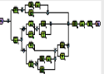
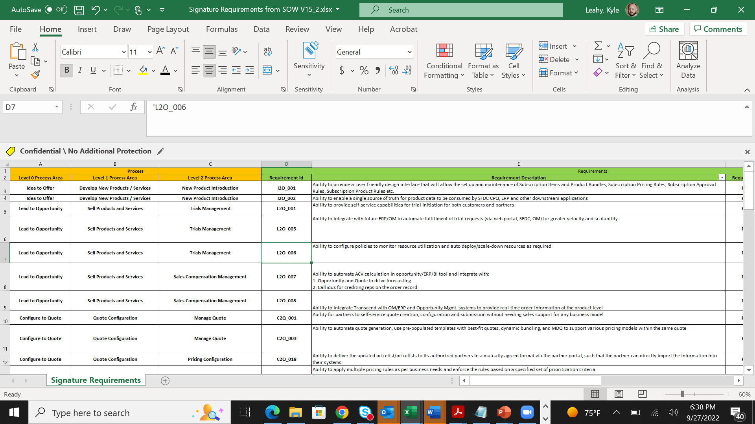
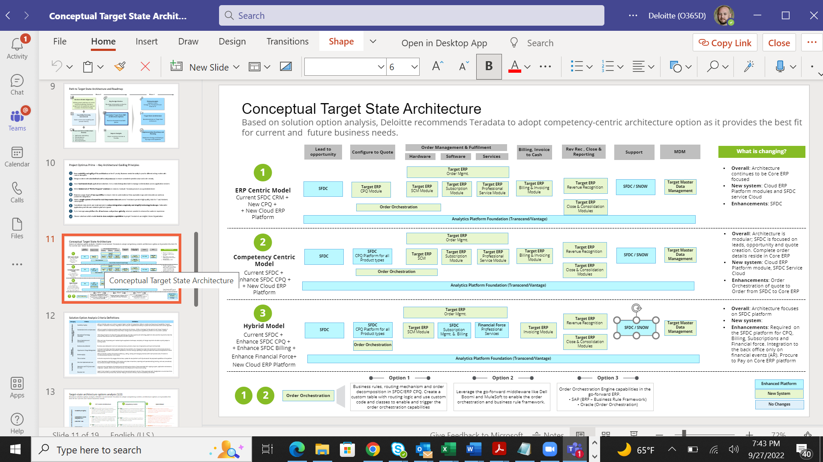
Workshop Approach
Deloitte will use Deloitte process flows, FlexTech (Oracle+SFDC) application process steps, signature requirements, and the enterprise application architecture to facilitate the exception-based design workshops
Key Elements
1
Process Flows
2
Application Process Steps
Walkthrough the select process steps requiring clarification, discussing topics that are Oracle related, Deloitte specific, or requiring clarification
Demonstrate how the application supports the various process steps out-of-the-box;
Walkthrough key setups
3
Confirm Process and Reporting Requirements
4
Confirm upstream and downstream applications
Validate requirements for the process and application which will be used to create features
Capture deep dive topics, KDDs, open items and questions. Confirm assumptions, POVs, features
Align on the boundary applications architecture for the implementation by each phase

Slide 56
Workshop Phases & Key Activities
The detailed design workshop approach is based on three phases. Some of the key activities (underlined = Deloitte activities) per phase are listed below:
Pre-Workshop
Identify participants
Schedule workshops
Send out Pre-workshop Questionnaires
Respond to pre-workshop questionnaires
Populate data request template
Distribute Data Request Template for Workshops
Prepare demo environment
Prepare workshop agenda
Prepare workshop materials
Configure Flex-Tech Instance for Demos
Gather Past Artifacts from previous Phase 0 work
During Workshop
Conduct Global Design Exception Based Design Workshop
Walk through process design
Identify and confirm requirements in scope
Capture and discuss content for cross functional team deliverables
Capture open issues, action items and “parking lot” items
Perform Recap and Closure
Post-Workshop
Review and Validate Business Processes:
Identify open issues, action items and Key Design Decisions (KDDs) that need to be documented and resolved
Plan, schedule and perform follow up meetings
Provide integration, data and architecture information to the data and architecture team
Provide approvals on resolved KDDs

Slide 57
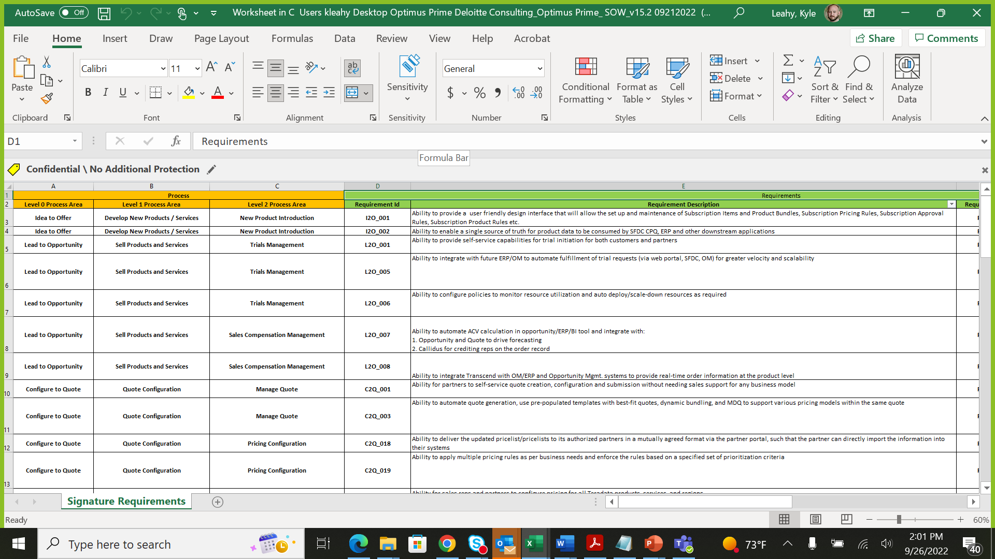
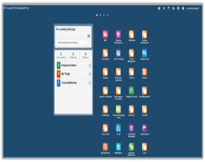
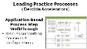
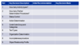
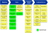

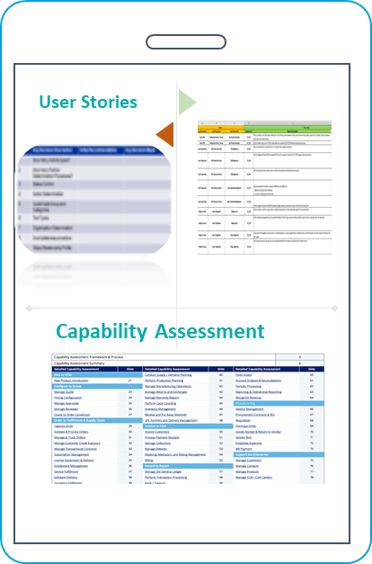
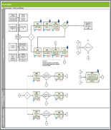
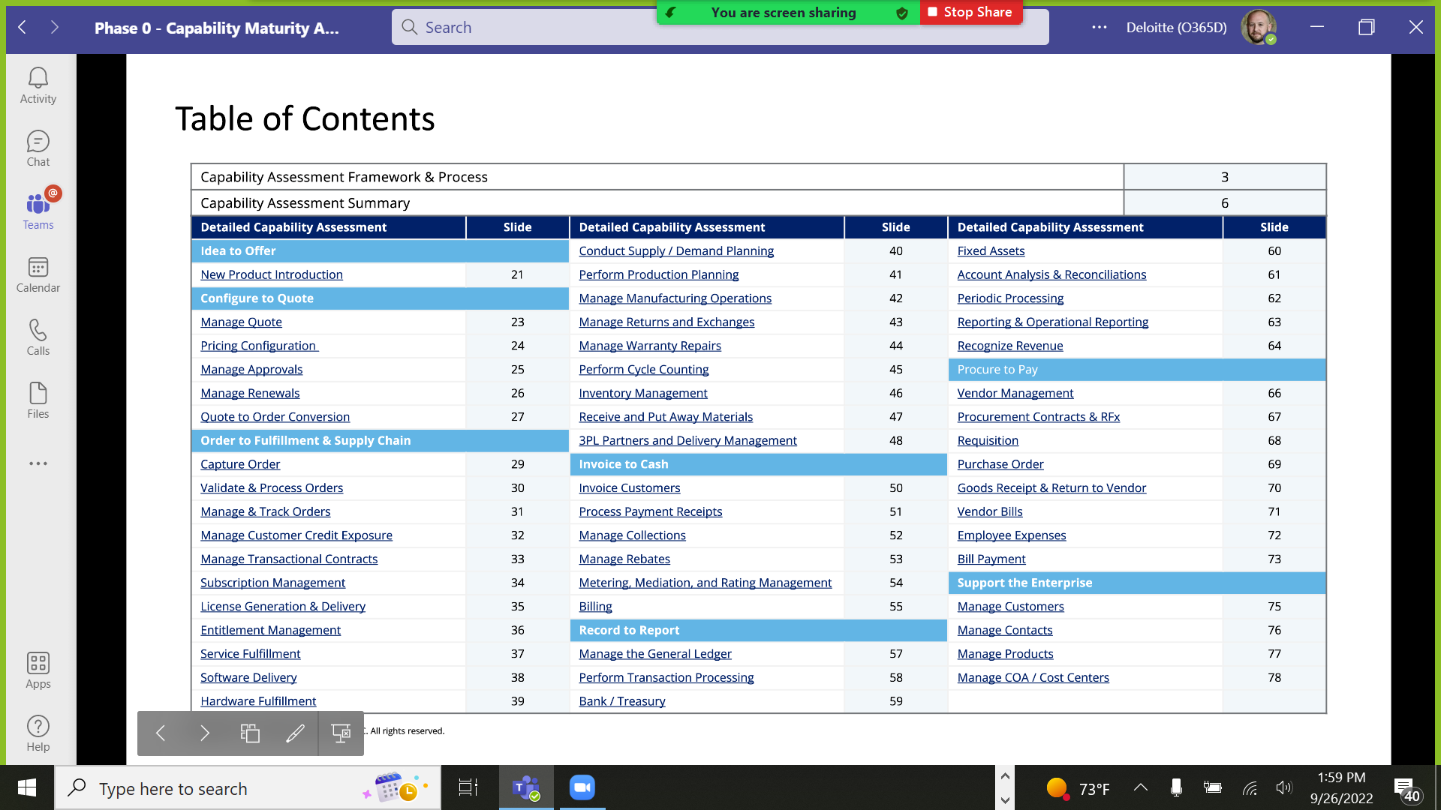
Workshop Expectations
We will use our foundational design workshops framework which follows a design by exception approach with the first 2 weeks having in person workshops . The approach, leveraging requirements based on our FlexTech™ SFDC+ Oracle preconfigured solution, is a “show and tell” method to validate business process and application design side by side.
Workshop
Active involvement of key resources is essential
Requirements
FlexTech (Oracle + SFDC)
Process Flows
Key Outcomes
User Stories
Scope and Governance
Initial foundational KDDs
Exception requirement list
Overall feature list
POV list for detailed design
Initial TD configurations
Initial TD configured sandbox
Process transactional flows
Initial list of key deployment consideration
Refined architecture by phase
Change impacts
CloudPrint: Leading Practice Processes
(Deloitte Accelerators)
Capability Assessment
Application Based Process Step Walkthrough
Discuss supporting decisions & configurations
Workshop Presenter
COMMAND CENTER
Participants:
TD SMAs
Deloitte SMAs
Change Management
Scribe

Slide 58
Roles & Responsibilities
 | Role | Owner | Responsibilities
 | Workshop Presenter | Deloitte | Set the stage and explain goals and objectives Walkthrough high level process related to their functions Provide subject matter expertise related to their functions and processes Drive discussion amongst the group Identify when items should be moved to a “parking lot”
 | Participants (IT & Business Process Leads, Business SMEs) | Deloitte | Pre Confirm participation for attendee list Respond to pre-workshop questionnaires questionnaire & data template focused on confirming requirements and sample data for demos During : Participate actively to provide subject matter expertise related to their functions, processes, and solutions Validate requirements in workshops Determine any additional requirements Raise any potential pain points not addressed Make Key Design Decisions Post Workshop: Provide additional information/ data on open KDDs View alternatives proposals presented by Deloitte Confirm Key Design Decisions
 | Scribe and Time Keeper | Deloitte | Document items that are out of scope on a “parking lot” Document issues or risks raised during the discussion Document action items and owners Manage time based on agenda and schedule
 | Change Management | Deloitte Deloitte | Draft Change Impacts Draft Change management strategy

Slide 59
Our Understanding
Our Understanding of Process/Topic
Pain Points
Treasury relies heavily on MS Excel, which makes making changes to banking structure very difficult.
Treasury management system (TMS) approval is pending to validate align with ERP + planning
Reporting from GL or HFM/IDW on different views (legal entity, by bank, by currency) of cash and investment is limited.
Manual journal entries are performed for IC loan revaluation, IC loan and external debt interest accruals, external debt issuance cost amortization, etc
Transaction currency reporting is difficult and unavailable in HFM/IDW.
IC settlement is a time consuming/ manual process performed in MS Excel. I would like to redenominate IC transactions from USD to local currency, centralizing FX risk on TD Ireland, establish multi-lateral netting process with streamlined intercompany posting/clearing.
Timing of certain entries/ accruals can create an issue with balance sheet exposures and hedge positions. India IC consulting, for example, is booked very late and has fx exposure implications. With balance sheet and P&L transaction currency reporting available, would examine our balance sheet hedging program and establish a cash flow hedging program.
Assumptions
Considerations

Slide 60
Agenda
Workshop Breakdown | Duration
Introductions: RTR Workstream Leads & Facilitators | 5 min
Session Overview: Global Design Topics | 5 min
Reminder: Rules of the Road | 2 min
Manage Bank Transactions L1/L2 Process Taxonomy Scope | 3 min
Manage Bank Transactions Topics Deep Dive | 120 min
Next Steps and Q&A | 15 min

Slide 61
Session Overview: Global Design Topics
Expectations
Topics
Manage Bank Transactions
Bank Account Maintenance
Bank Statement Processing
Reconciliation
Cash Forecasting
Cash Positioning
Bank Account Transfer
Define key Concepts
Overview of Personas
Standard Future State Process Walkthrough
Leading Practices & Key Design Decisions
Parking Lot Items

Slide 62
Rules of the Road
Rules of the Road
All participants are expected to actively participate and contribute to the sessions; please avoid outside work and other distractions during this time (e.g. email, instant message, and texting) All participants are expected to come to the sessions prepared by reading and understanding all provided materials All participants must focus on the session objectives, and drive to achieve the desired outcomes within the allocated time. Debate is good but limit it to meaningful discussion Avoid “piling-on” (i.e., extended comments/speaking) so that everyone has a fair chance to speak If a question/answer and debate takes longer than 5 mins, the item will be placed in the parking lot
PLEASE BE ON MUTE IF YOU ARE NOT SPEAKING
REMAIN ENGAGED
USE CHAT BUTTON ON TEAMS SITE TO POST YOUR QUESTIONS
YOUR QUESTIONS WILL BE TRIAGGED AND ANSWERED EITHER THROUGH TEAMS CHAT OR DURING Q&A

Slide 63
Week 2 – Workshop Schedule –
In person workshops in San Diego, CA​
Time | 10/24 | 10/25 | 10/26 | 10/27 | 10/28
8
9
10
11
12 | Lunch | Lunch | Lunch | Lunch | Lunch
1
2
3
4
5
GTM
GTM
Manage License Generation & Transactional Contracts
Account Management
(SFDC)
Product Management
(SFDC)
All
GTM
Manage Install Base
GTM
GTM
Opportunity Management
(SFDC)
Business Teams and Access (SFDC)
Inv Mgmt.
GTM
Working Lunch/
Week 2 Recap
PMO
Thank you – Safe Travels
TD/DT PMO Workshops
Transaction Processing
Inv Mgmt.
FIN
Subscription Billing
GTM
FIN
Entitlement & Subscription
GTM
FIN
Account Analysis & Recon.
FIN
Billing & Invoicing
Daily Recap
Daily Recap
Daily Recap

Slide 64
User Persona – Bank Statement Processing and Reconciliation
Role | Role Description | Responsibilities
Cash Management Analyst​ | Receive bank statements and perform reconciliation​ | Manually enter bank statements​ Import bank statements in case of electronic bank statement​ Reconcile bank statement​
Cash Management Supervisor​ | Verify the bank reconciliation process​ | Review bank reconciliation​ Resolve errors in auto reconciliation process​

Slide 65
Bank Statements
Cash Management maintains information for each bank statement to reconcile. Use the Cash Management Bank Statement Open Interface to load bank statement information supplied by bank or enter and update bank statements manually. The system retains all bank statement information for audit and reference purposes, until we purge it.
Transactions that are posted directly in cash management like, bank account transfers, Adhoc payments, etc. can only be accounted into General Ledger once it is reconciled with the bank statement. This ensures full controls are in place before a transaction is accounted.
Each Cash Management bank statement is composed of one bank statement header and multiple bank statement lines. The bank statement header identifies the statement number, bank account number, and statement date. It also contains optional information including the bank and branch names, bank account currency, and control amounts.
Bank Statement Lines:
A bank statement line can refer to one or more payments, receipts, cashflows, miscellaneous transactions, open interface transactions, or journal entry lines.
Each line has a line number, transaction type, date cleared (bank transaction date), and amount. Optional line information includes the bank transaction code, number, bank transaction identifier (such as the payment or deposit number), currency information (currency code, original amount in transaction currency, exchange rate), value date, agent (customer or supplier), agent bank account, a comment, and a descriptive flexfield for user-defined additional information.

Slide 66
Bank Statements Lines (cont..)
A bank statement line's status can be one of the following:
Reconciled: Some transactions have been matched against this line. The statement line may not be fully reconciled.
Unreconciled: No transactions have been matched.
Error: This status is a warning that the line cannot be reconciled because of a bank error in the statement that cannot be resolved. We must manually mark the statement line as Error. The transaction remains unreconciled because there is no corresponding transaction to which the line can be reconciled.
External: The line does not correspond to any transaction in General Ledger, Payables, Receivables, Payroll, Cash Management, or the Reconciliation Open Interface, but corresponds to a transaction in another system. We then manually mark the statement line as External. Cash Management treats it as reconciled.
Bank Statement Transaction Codes
Bank statement lines are coded to identify the type of transaction the line represents. Since each bank might use a different set of transaction codes, we need to map each code to a bank uses.
This code will help in performing Auto-Reconciliation for uploaded Bank Statements from Banks

Slide 67
Process Taxonomy
User Personas
Process Flow
Pain Points
Signature Requirements
Cash Management
Oracle Cash Management is an enterprise cash management solution that helps effectively manage and control cash cycle. It provides comprehensive bank reconciliation and flexible cash forecasting. This will enable the Customer to quickly analyze cash positions and forecast cash requirements through configurable dashboards, work areas, and reports, ensuring liquidity and optimal use of cash resources.

Slide 68
Leading Practices
No | Category | Leading Practice
1​ | Bank Statements​ | Utilize standard bank statements formats across all entities (to the extent possible)​ Automate bank statement interface as much as possible​ Bank statement should provide appropriate details for ease of reconciliation. (ex - bank name, bank branch, bank account number, reference number, payment number, receipt, check number)​
2​ | Bank Reconciliations​ | Utilize automate bank reconciliations and restrict manual reconciliation only for resolving discrepancies​
3 | Bank Accounts | Maintain quality of Master data e.g: Avoid creating duplicate bank or branches Establish a way to uniquely tie a GL account/ account combination to each bank account enabling faster reconciliation of GL with Bank statement

Slide 69
Key Design Decisions
No. | Decision | Description
1​ | Bank Statement Import Format​ | Determine the format of the bank statement to import and upload the bank statement directly into the system​
2​ | Bank Statement Processing and Reconciliation​ | Determine the different type of transactions​ Determine the method used for reconciliation of bank statements with other modules like payables and receivables​ Determine the process to apply bank charges​ Determine the option for multiple currency transactions to enable at bank account setup level​
3​ | Cash Management reporting​ | Determine the reports to generate for cash management reporting requirement​

